Slide 1
Servlets
PMCA502L: Thilagavathi M, AP(Sr.), SCORE

Slide 2
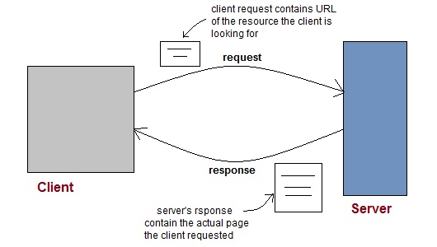
Introduction to Web
PMCA502L: Thilagavathi M, AP(Sr.), SCORE

Slide 3
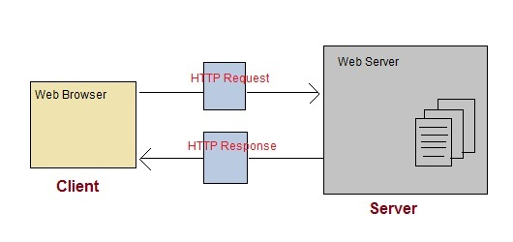
HTTP
PMCA502L: Thilagavathi M, AP(Sr.), SCORE

Slide 4
HTTP Important Methods
GET
POST
OPTIONS
DELETE
HEAD
PMCA502L: Thilagavathi M, AP(Sr.), SCORE

Slide 5
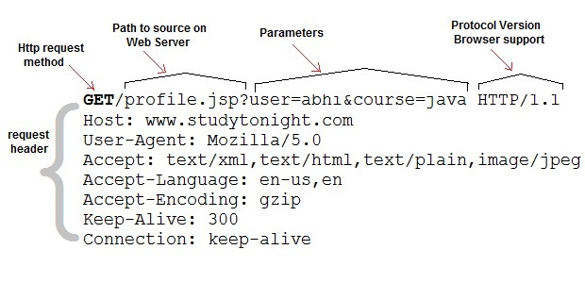
Anatomy of a HTTP GET request
PMCA502L: Thilagavathi M, AP(Sr.), SCORE

Slide 6
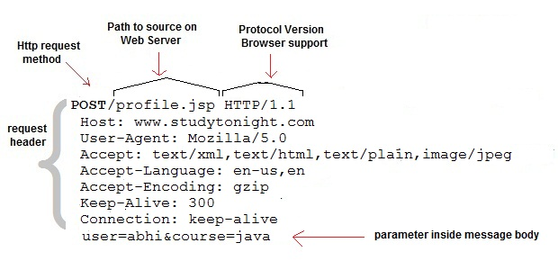
Anatomy of a HTTP POST request
PMCA502L: Thilagavathi M, AP(Sr.), SCORE

Slide 7
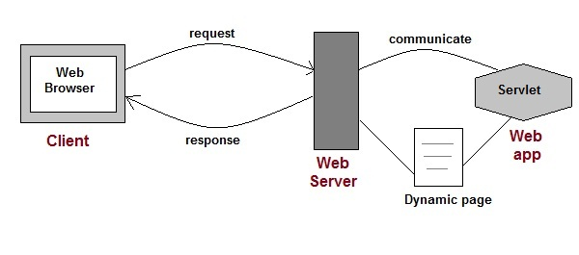
Servlet
PMCA502L: Thilagavathi M, AP(Sr.), SCORE

Slide 8
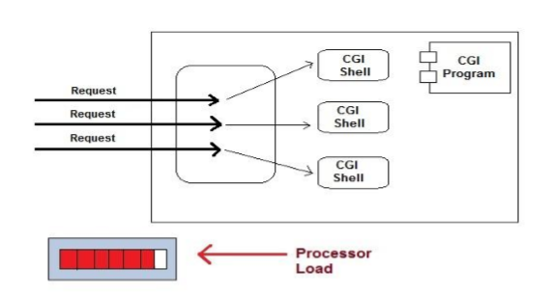
CGI
PMCA502L: Thilagavathi M, AP(Sr.), SCORE

Slide 9
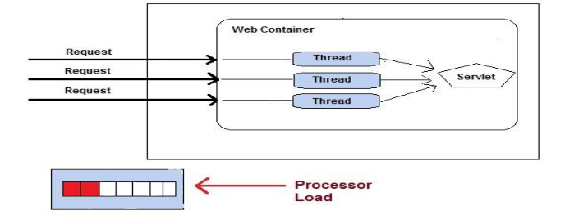
Advantages of Servlets over Traditional CGI
Less response time because each request run in a separate thread.
Servlet are scalable.
Servlet are robust and object oriented.
Servlet are platform independent.
PMCA502L: Thilagavathi M, AP(Sr.), SCORE

Slide 10
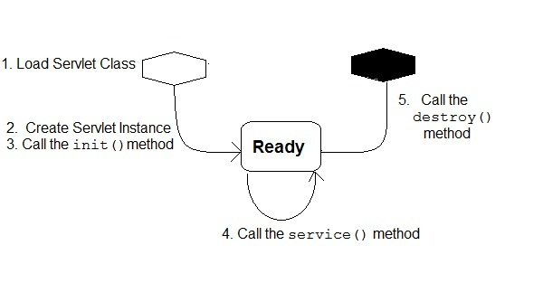
Servlet Life Cylce
PMCA502L: Thilagavathi M, AP(Sr.), SCORE

Slide 11
How does a Servlet Application Work?
PMCA502L: Thilagavathi M, AP(Sr.), SCORE

Slide 12
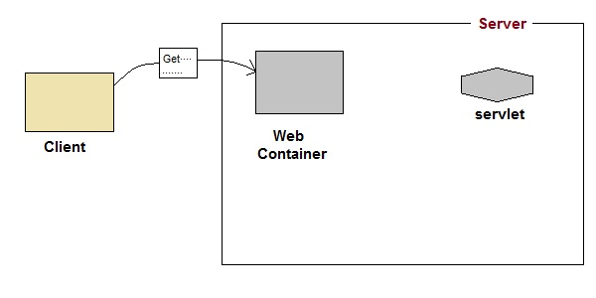
How does a Servlet Application Work?
1) User sends request for a servlet by clicking a link that has URL to a servlet.
PMCA502L: Thilagavathi M, AP(Sr.), SCORE

Slide 13
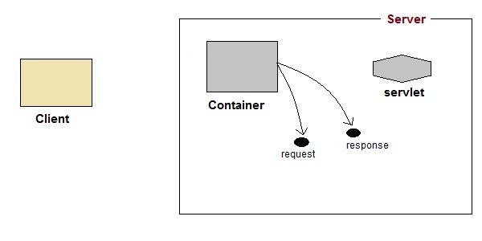
How does a Servlet Application Work?
2) The container finds the servlet using deployment descriptor and creates two objects
HttpServletRequest
HttpServletResponse
PMCA502L: Thilagavathi M, AP(Sr.), SCORE

Slide 14
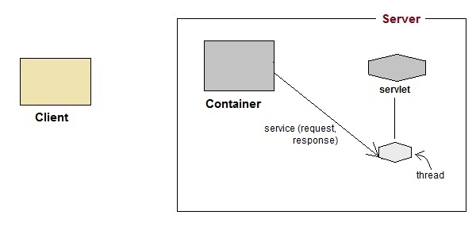
How does a Servlet Application Work?
3) The container creates or allocates a thread for that request and calls the servlet's service() method and passes the request, response objects as argument
PMCA502L: Thilagavathi M, AP(Sr.), SCORE

Slide 15
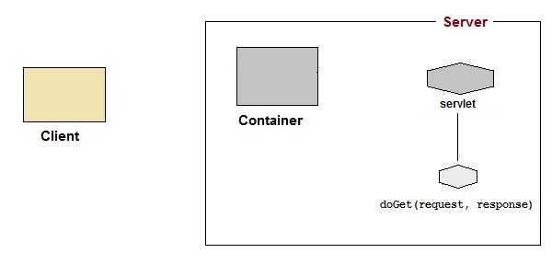
How does a Servlet Application Work?
4) The service method decides which servlet method doGet() or doPost() to call based on HTTP Request Method(Get,Post) sent by the client.
PMCA502L: Thilagavathi M, AP(Sr.), SCORE

Slide 16
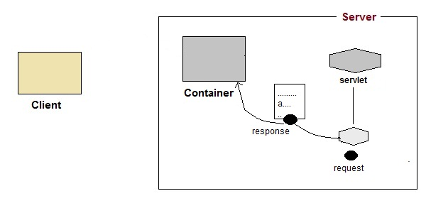
How does a Servlet Application Work?
5) The servlet uses response object to write the response back to the client
PMCA502L: Thilagavathi M, AP(Sr.), SCORE

Slide 17
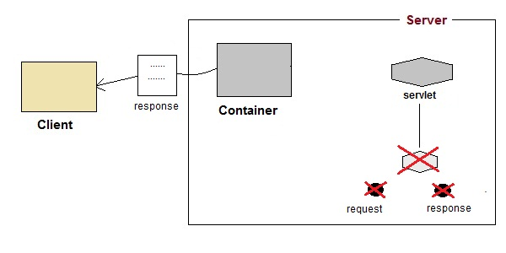
How does a Servlet Application Work?
6) After the service() method is completed the thread dies. The request and response object are ready for garbage collection
PMCA502L: Thilagavathi M, AP(Sr.), SCORE

Slide 18
Servlet Program Essentials
For a class to behave as a servlet, it should extend HttpServlet and override doGet or doPost, depending on whether the data is being sent by GET or by POST.
Both doGet and doPost take two arguments: an HttpServletRequest and an HttpServletResponse.
The HttpServletRequest has methods by which you can find out about incoming information such as form (query) data, HTTP request headers, and the client’s hostname.
The HttpServletResponse lets you specify outgoing information such as HTTP status codes (200, 404, etc.) and response headers (Content-Type, Set-Cookie, etc.). Mainly it helps to obtain a PrintWriter with which you send the document content back to the client.
PMCA502L: Thilagavathi M, AP(Sr.), SCORE

Slide 19
Servlet Program Essentials
Since doGet and doPost throw two exceptions, “throws ServletException, IOException” should be included in the method header.
Finally, you must import classes in java.io (for PrintWriter, ), javax.servlet (for HttpServlet, etc.), and javax.servlet.http (for HttpServletRequest and HttpServletResponse).
PMCA502L: Thilagavathi M, AP(Sr.), SCORE

Slide 20
Servlet API
Servlet API consists of two important packages
  javax.servlet
  javax.servlet.http
PMCA502L: Thilagavathi M, AP(Sr.), SCORE

Slide 21
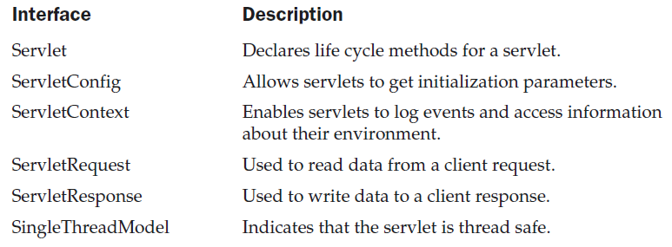
javax.servlet
Some Important Classes and Interfaces of javax.servlet
PMCA502L: Thilagavathi M, AP(Sr.), SCORE

Slide 22

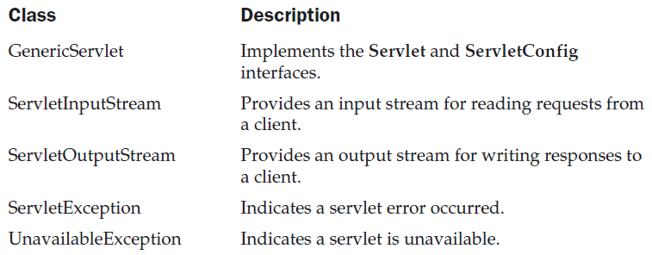
javax.servlet
PMCA502L: Thilagavathi M, AP(Sr.), SCORE

Slide 23
Servlet Interface
Methods
void init(ServetConfig config) throws ServletException
void service(ServletRequest req, ServletResponse resp)
throws ServletException, IOException
void destroy()
String getServletInfo()
ServletConfig getServetConfig()
PMCA502L: Thilagavathi M, AP(Sr.), SCORE

Slide 24
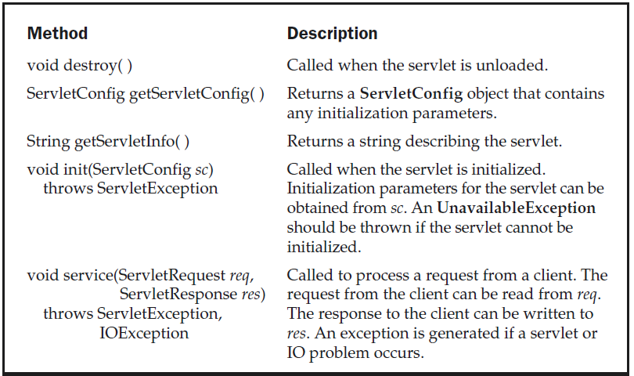
Servlet Interface
Methods
void init(ServetConfig config) throws ServletException
ServletConfig getServletConfig()
void service(ServletRequest req, ServletResponse resp)
throws ServletException, IOException
String getServletInfo()
void destroy()
PMCA502L: Thilagavathi M, AP(Sr.), SCORE

Slide 25
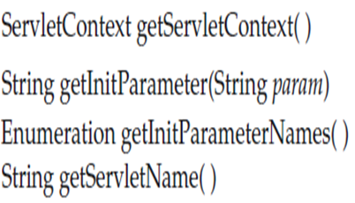
ServletConfig Interface
PMCA502L: Thilagavathi M, AP(Sr.), SCORE

Slide 26
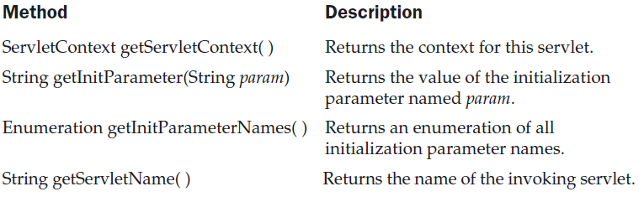
ServletConfig Interface
PMCA502L: Thilagavathi M, AP(Sr.), SCORE

Slide 27
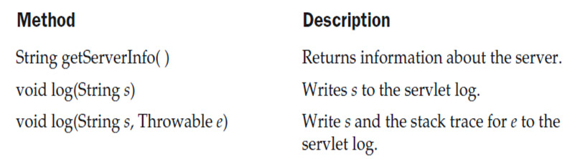
ServletContext Interface
PMCA502L: Thilagavathi M, AP(Sr.), SCORE

Slide 28
ServletRequest Interface
int getContentLength()
String getContentType()
ServletInputStream getInputStream()
BufferedReader getReader()
String getParameter(String pname)
String[] getParameterValues(String pname)
Enumeration getParameterNames()
String getProtocol()
String getRemoteAddr()
String getRemoteHost()
String getScheme()
String getServerName()
String getServerPort()
PMCA502L: Thilagavathi M, AP(Sr.), SCORE

Slide 29
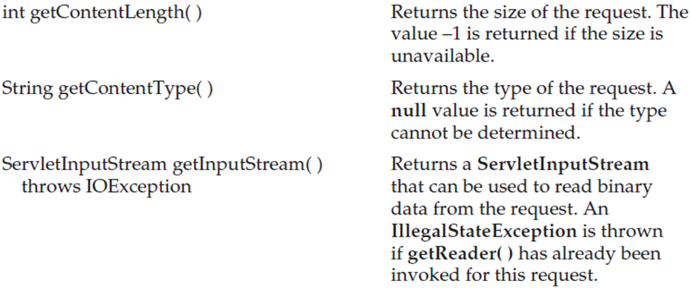
ServletRequest Interface
PMCA502L: Thilagavathi M, AP(Sr.), SCORE

Slide 30
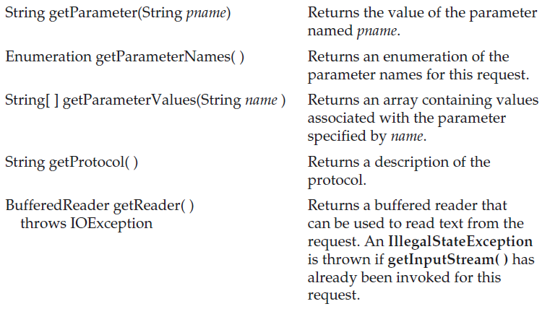
ServletRequest Interface
PMCA502L: Thilagavathi M, AP(Sr.), SCORE

Slide 31
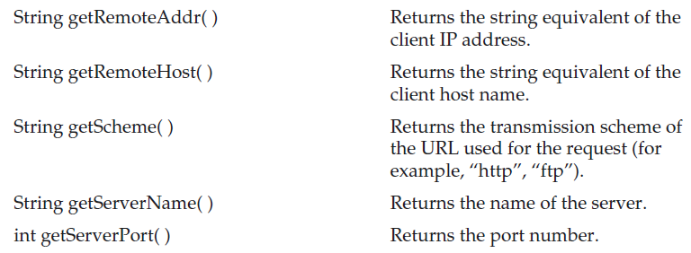
ServletRequest Interface
PMCA502L: Thilagavathi M, AP(Sr.), SCORE

Slide 32
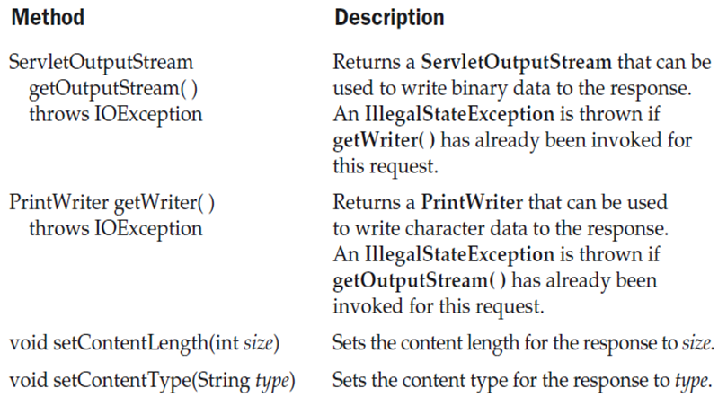
ServletResponse Interface
PMCA502L: Thilagavathi M, AP(Sr.), SCORE

Slide 33
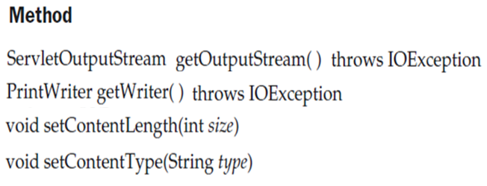
ServletResponse Interface
PMCA502L: Thilagavathi M, AP(Sr.), SCORE

Slide 34
GenericServlet
Provides implementations of the basic life cycle methods for a servlet.
Implements Servlet and ServletConfig interfaces.
Additional methods
void log(String s)
void log(String s, Throwable e)
PMCA502L: Thilagavathi M, AP(Sr.), SCORE

Slide 35
<html>
<head>
<title>Sample</title>
</head>
<body>
<Form Name="Form1" Method="post" action="PostParametersServlet">
<Table>
<tr>
<td><b> Employee Name</td>
<td> <input type="text" name="e" size="25" value=""> </td>
</tr>
<tr>
<td><b>Phone</td>
<td> <input type="text" name="p" size="25" value=""> </td>
</tr>
</Table>
<input type="submit" value="Submit">
</Form>
</body>
</html>

Slide 36
import java.io.*;
import java.util.*;
import javax.servlet.*;
public class PostParametersServlet extends GenericServlet {
public void service(ServletRequest request, ServletResponse response)
throws ServletException, IOException {
PrintWriter out = response.getWriter();
Enumeration e=request.getParameterNames();
while(e.hasMoreElements())
{
String pname=(String)e.nextElement();
out.print(pname + " = ");
String value=request.getParameter(pname);
out.println(value);
}
out.close();
}
}

Slide 37

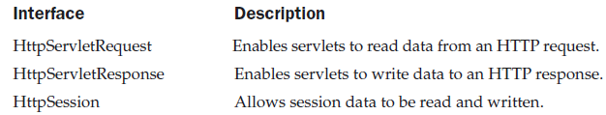
javax.servlet.http
PMCA502L: Thilagavathi M, AP(Sr.), SCORE

Slide 38
HTTPServlet
The HttpServlet class is an abstract class that extends the GenericServlet class and implements a Serializable interface.
PMCA502L: Thilagavathi M, AP(Sr.), SCORE

Slide 39
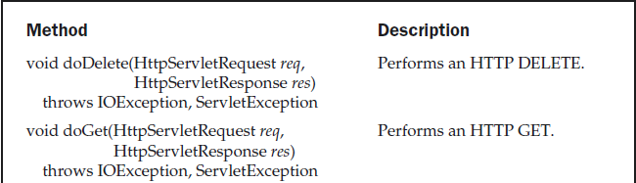
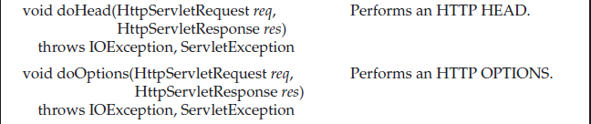
HttpServlet Class
PMCA502L: Thilagavathi M, AP(Sr.), SCORE

Slide 40
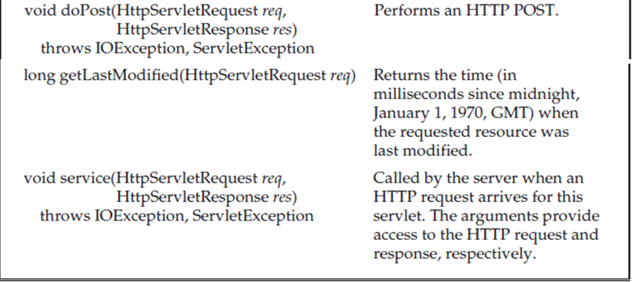
HttpServlet Class
PMCA502L: Thilagavathi M, AP(Sr.), SCORE

Slide 41
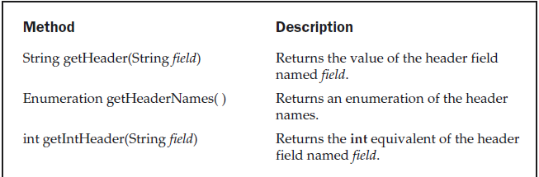
HttpServletRequest Interface
(Extends ServletRequest Interface)
PMCA502L: Thilagavathi M, AP(Sr.), SCORE

Slide 42
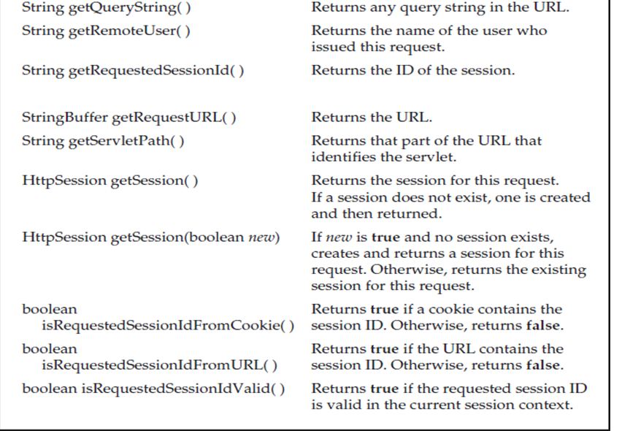
HttpServletRequest Interface
PMCA502L: Thilagavathi M, AP(Sr.), SCORE

Slide 43
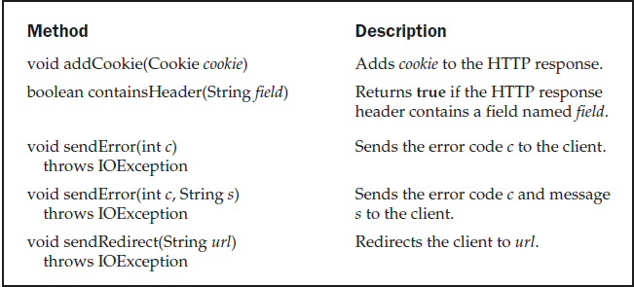
HttpServletResponse Interface
(Extends ServletRequest Interface)
PMCA502L: Thilagavathi M, AP(Sr.), SCORE

Slide 44
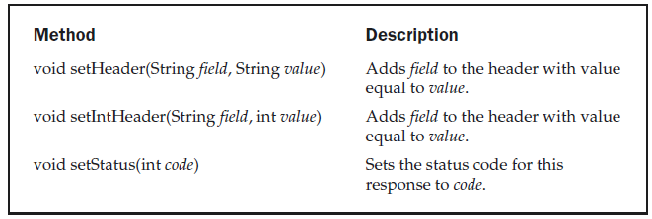
HttpServletResponse Interface
PMCA502L: Thilagavathi M, AP(Sr.), SCORE

Slide 45
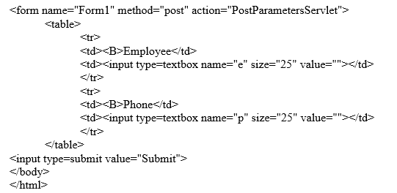
Example 1
PMCA502L: Thilagavathi M, AP(Sr.), SCORE

Slide 46
import java.io.*;
importjava.util.*;
importjavax.servlet.*;
public class PostParametersServlet extends HttpServlet {
public void doGet(HttpServletRequest request, HttpServletResponse
response) throws ServletException, IOException
{
  PrintWriter pw = response.getWriter();
  Enumeration e = request.getParameterNames();
  while(e.hasMoreElements( )) {
  String pname = (String)e.nextElement();
  pw.print(pname + " = ");
  String pvalue = request.getParameter(pname);
  pw.println(pvalue);
}
pw.close();
}
}
PMCA502L: Thilagavathi M, AP(Sr.), SCORE

Slide 47
Example
html>
<head>
</head>
<body>
<form name="Form1" action="GetColorServlet">
<B>Color:</B>
<select name="color" size="1">
<option value="Red">Red</option>
<option value="Green">Green</option>
<option value="Blue">Blue</option>
</select>
<br><br>
<input type=submit value="Submit">
</form>
</body>
</html>
PMCA502L: Thilagavathi M, AP(Sr.), SCORE

Slide 48
import java.io.IOException;
import java.io.PrintWriter;
import javax.servlet.ServletException;
import javax.servlet.http.HttpServlet;
import javax.servlet.http.HttpServletRequest;
import javax.servlet.http.HttpServletResponse;
public class GetColorServlet extends HttpServlet {
public void doGet(HttpServletRequest request,
HttpServletResponse response)
throws ServletException, IOException
{
String color = request.getParameter("color");
response.setContentType("text/html");
PrintWriter pw = response.getWriter();
pw.println("<B>The selected color is: ");
pw.println(color);
pw.close();
}
}
PMCA502L: Thilagavathi M, AP(Sr.), SCORE

Slide 49
Servlet with DB
<html>
<head>
<title>Servlet DB</title>
</head>
<body>
<Form name="form1" method="post" action="NewServlet_DB">
Enter ID: <Input Type="text" name="id"><BR>
Enter Name: <Input Type="text" name="name"><BR>
Enter Total: <Input Type="text" name="total"><BR>
Enter CGPA: <Input Type="text" name="cgpa"><BR>
<input type="submit" value="Submit">
</Form>
</body>
</html>
PMCA502L: Thilagavathi M, AP(Sr.), SCORE

Slide 50
Servlets with DB
public class NewServlet_DB extends HttpServlet {
Connection c=null; Statement s=null; ResultSet rs=null;
protected void processRequest(HttpServletRequest request, HttpServletResponse response) throws ServletException, IOException {
try{
Class.forName("org.apache.derby.jdbc.ClientDriver");
c=DriverManager.getConnection("jdbc:derby://localhost:1527/Login;
create=true;user=test;password=test");
System.out.println("Connection established");
s=c.createStatement();
String id=request.getParameter("id");
String name=request.getParameter("name");
int total = Integer.parseInt(request.getParameter("total"));
double cgpa=Double.parseDouble(request.getParameter("cgpa"));
int n=s.executeUpdate("INSERT INTO student
VALUES('"+id+"','"+name+"',"+total+","+cgpa+")"); response.setContentType("text/html;charset=UTF-8");
PrintWriter out = response.getWriter();
if(n==1)
out.println("<h2>Inserted<h2>");
rs.close(); s.close(); c.close();
}
catch(SQLException | ClassNotFoundException e){
System.out.println(e);
}
}
PMCA502L: Thilagavathi M, AP(Sr.), SCORE

Slide 51
@Override
protected void doGet(HttpServletRequest request, HttpServletResponse
response) throws ServletException, IOException {
processRequest(request, response);
}
@Override
protected void doPost(HttpServletRequest request,
HttpServletResponse response) throws ServletException, IOException
{
processRequest(request, response);
}
}
PMCA502L: Thilagavathi M, AP(Sr.), SCORE

